Slide 1

Project(P402) Recommendation System
Group :- 2
Mahesh Pal
Vijay Kamble
Farwa Rabbab
Mayuresh Gore
Lionel Mendonsa
Dhanashri Kanukale

Slide 2
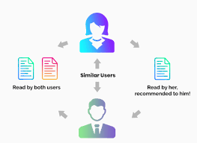
What is Recommendation System ?
A recommendation system is an artificial intelligence or AI algorithm, usually associated with machine learning, that uses Big Data to suggest or recommend additional products to consumers.
These can be based on various criteria, including past purchases, search history, demographic information, and other factors.
Eg:- Amazon,Netflix,Youtube,etc.

Slide 3
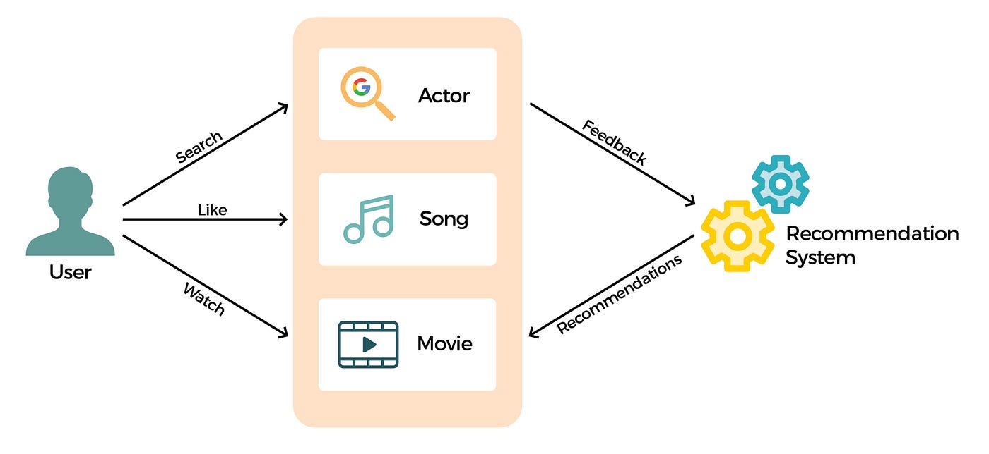
Recommendation System Process
Collecting data
Analyzing data
Filtering data
Generating Recommendations

Slide 4
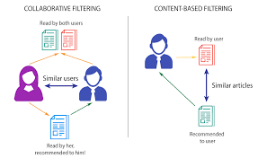
Types Of Recommendation System
Collaborative Filtering:- The collaborative filtering method is based on gathering and analyzing data on user’s behavior. This includes the user’s online activities and predicting what they will like based on the similarity with other users.
Content-Based Filtering:- Content-based filtering methods are based on the description of a product and a profile of the user’s preferred choices. In this recommendation system, products are described using keywords, and a user profile is built to express the kind of item this user likes.

Slide 5

Objective
To develop an intelligent book recommendation system using machine learning techniques that provides personalized book suggestions to users based on their preferences and behaviors.
Enhance User Experience:- Improve user satisfaction by recommending books that align with their interests and reading habits.
Leverage Data:- Utilize user data (e.g., ratings, reviews, reading history) and book metadata (e.g., genre, author) to generate accurate recommendations.

Slide 6
ABOUT DATASET
User Data: Provides demographic information and location of users.
Book Data: Contains detailed metadata about each book.
Ratings Data: Captures the interactions (ratings) between users and books, essential for training the recommendation model.

Slide 7
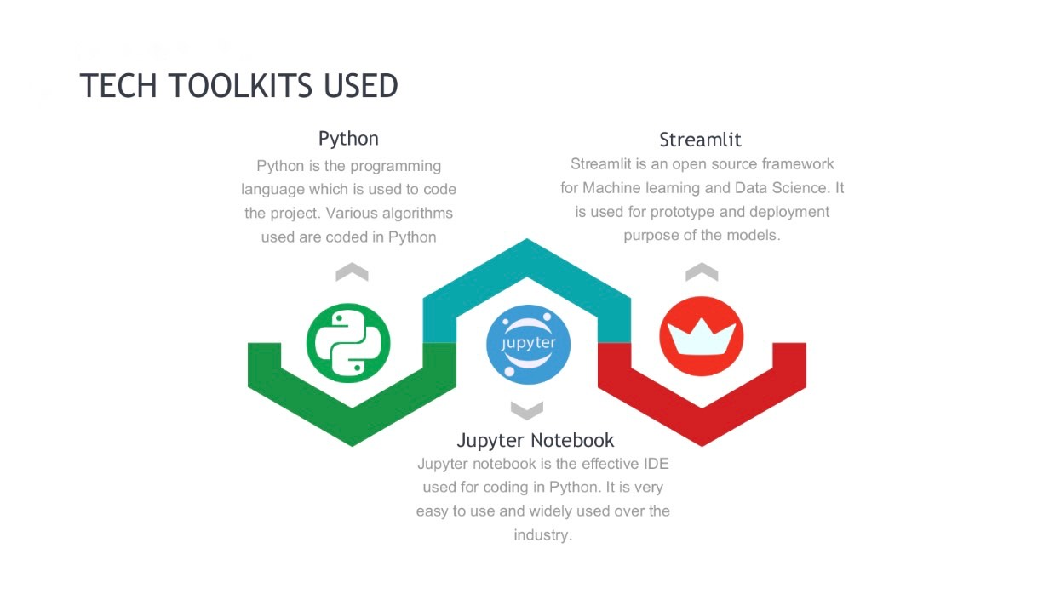

Slide 8
Algorithm Used in Project
Popularity-Based Filtering
Model-Based Collaborative Filtering
Singular Value Decomposition (SVD)
Non-negative Matrix Factorization (NMF)
Grid Search Cross Validation
K-Nearest Neighbors (KNN)

Slide 9
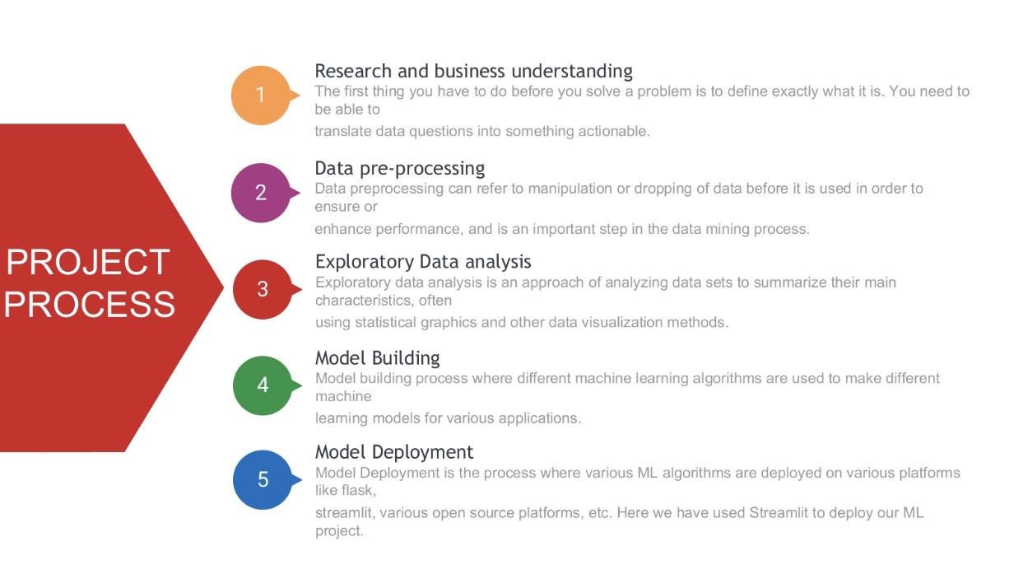

Slide 10
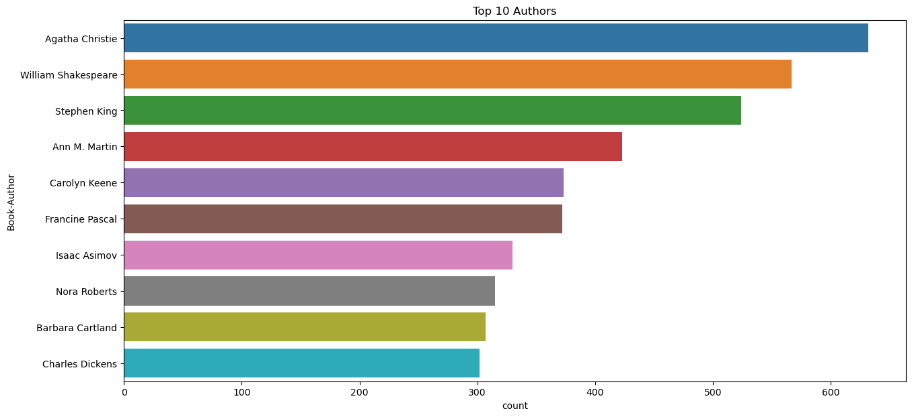
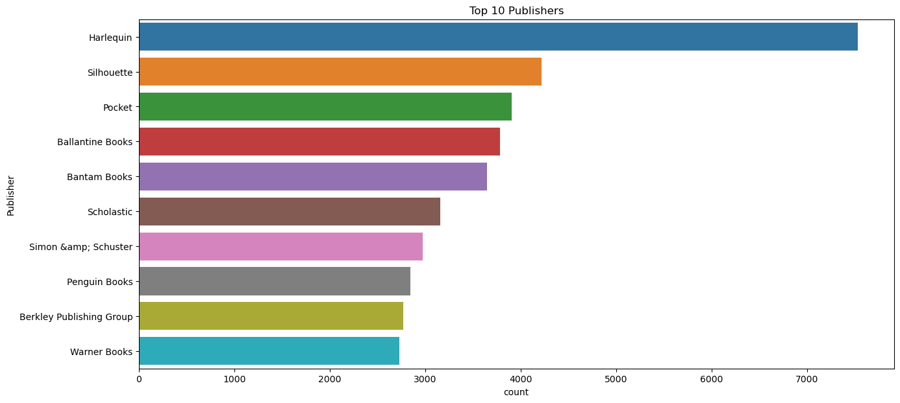
VISUALIZATION OF DATA

Slide 11
BEST MODEL
Once the data is cleaned and feature extraction is done.
The structured data is fitted into the best model evaluating the Train and Test accuracy.
The best model suitable for our data is:
Singular Value Decomposition (SVD)

Slide 12
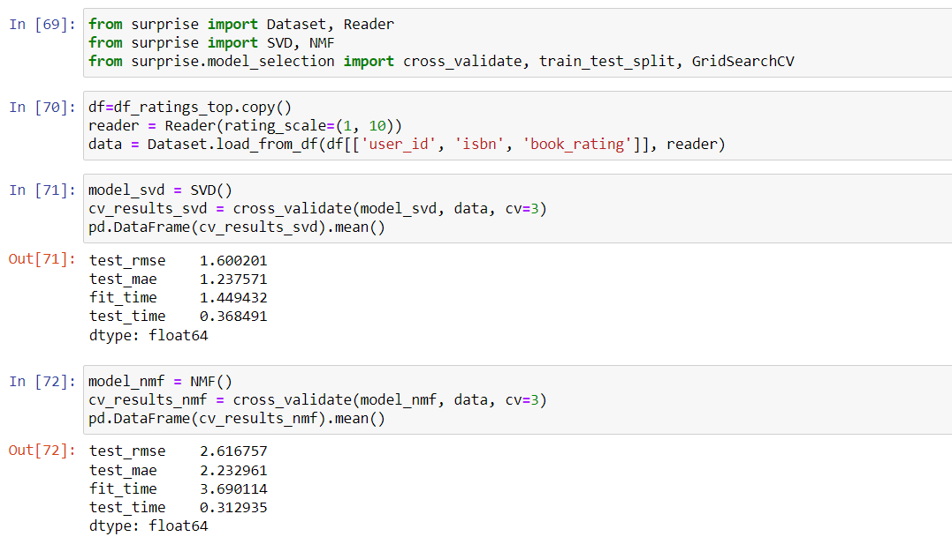
BEST MODEL

Slide 13
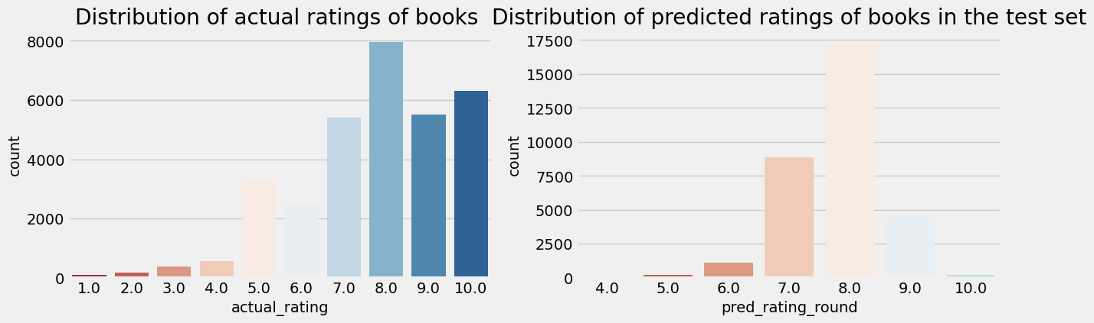
BEST MODEL

Slide 14
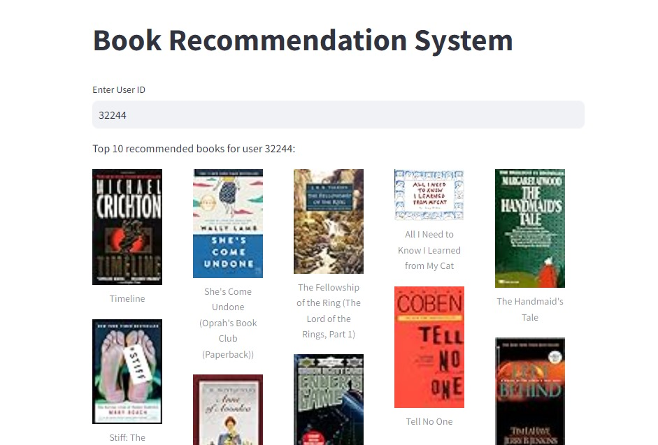
OUTPUT

Slide 15
CHALLENGES FACED
Incomplete and Inconsistent Data: Handling missing values and inconsistent entries in user age, book publication years, and author details.
Parameter Tuning: Finding the best hyperparameters for the SVD model to ensure optimal performance.
New Users and Items: Recommending books to new users who have not rated any books or introducing new books with no ratings.
Real-Time Monitoring: Keeping track of the system’s performance in real-time and identifying bottlenecks or failures.

Slide 16
THANK YOU

